Slide 1
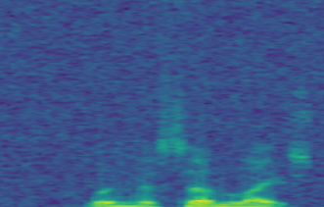
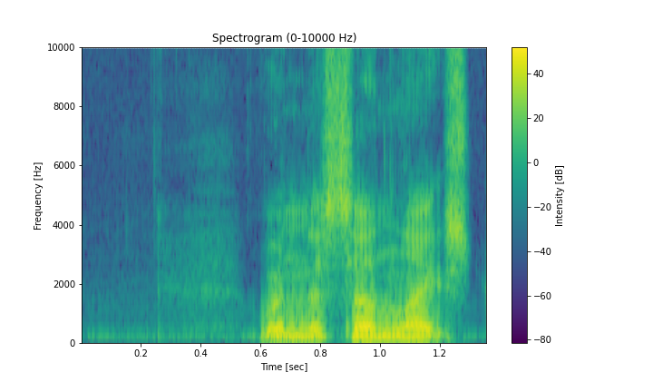
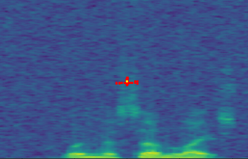
Features from y
Features from y
Features from y
Features from 3x3
Features from x
Features from 1x1
Features from x
Features from 1x1
Features from x
Features from x
Features from x
Features from y
Features from 1x1
Multi-view Feature Fusion Strategy
Features from x
Features from y
Features from 1x1
y
Features from y
Concat
Features from 3x3
Features Maps
(real part)
x
DSConv
3×3conv
Conv1x1
y
Channel 1 ~ Channel N
(real part)
Channel 1 ~ Channel N
(imag part)
Network Input Noise(b)
x
SE
Overlapping noise
Features Maps
(imag part)
DSConv
3×3conv
GN
K_{j+4}
K_{j+2}
K_{j+3}
K_{i-4}
K_{i-3}
K_{i-2}
K_{j+1}
K_{i+1}
K_{i+2}
K_{ij}
K_{i+4}
columnar
structure
K_{i-1}
K_{j-1}
K_{i+3}
K_{j-2}
K_{j-3}
K_{j-4}
Clean speech(a)
DSConv adapt the shape of its convolution kernel
Shape of the convolution kernel with SDFU(c)
Real part Feature
Concat
Concatenate along the last dimension
GN
Group Normalization
SE
Squeeze-and-Excitation
Imaginary part Feature
Features from x
Features from y
Features from 3x3
Features from y
Features from x
Features from 3x3
Features from x
Features from y
Features from 3x3
Features from y
Features from x
Features from 3x3
Chennel 2
Features from y
Features from 3x3
GN
Features from y
Features from y
Features from x
Features from y
Features from 1x1
Features from y
Features from x
Features from 1x1
Features from 3x3
Conv1x1
Features from x
Features from 1x1
Features from x
Features from x
Chennel N
Multi-view feature fusion strategy

Slide 2
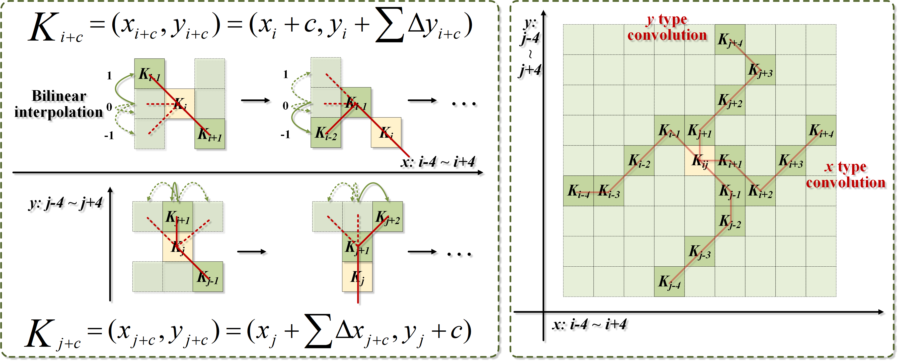
K_{ij}
K_{j+4}
K_{j+2}
K_{j+3}
K_{i-4}
K_{i-3}
K_{i-2}
K_{j+1}
K_{i+1}
K_{i+2}
K_{ij}
K_{i+4}
K_{i-1}
K_{j-1}
K_{i+3}
K_{j-2}
K_{j-3}
K_{j-4}

